Slide 1
Chapter 4: Project Integration Management
Information Technology Project Management, Eighth Edition
Note: See the text itself for full citations.

Slide 2
Learning Objectives (1 of 2)
Describe an overall framework for project integration management
as it relates to the other project management knowledge areas and the project life cycle
Discuss the strategic planning process and
apply different project selection methods
Explain the importance of creating a project charter to formally initiate projects
Describe project management plan development,
understand the content of these plans, and
describe approaches for creating them
Explain project execution, its relationship to project planning, the factors related to successful results, and tools and techniques to assist in directing and managing project work

Slide 3
Learning Objectives (2 of 2)
Apply the principles of knowledge management to the various aspects of project integration
Describe the process of monitoring and controlling a project
Define the integrated change control process, relate this to the steps for planning for and managing changes on information technology (IT) projects, and create an appropriate change control system for a project that incorporates both
Explain the importance of developing and following good procedures for closing projects
Describe how software can assist in project integration management
Discuss considerations for agile/adaptive environments

Slide 4
What is Project Integration Management? (1 of 3)
Project managers must coordinate all of the other knowledge areas throughout a project’s life cycle
Many new project managers have trouble looking at the “big picture” and want to focus on too many details (See opening case for a real example)
Project integration management is not the same thing as software integration

Slide 5
What is Project Integration Management? (2 of 3)
Main processes
Developing the project charter
Developing the project management plan
Directing and managing project work
Monitoring and controlling project work
Performing integrated change control
Closing the project or phase

Slide 6
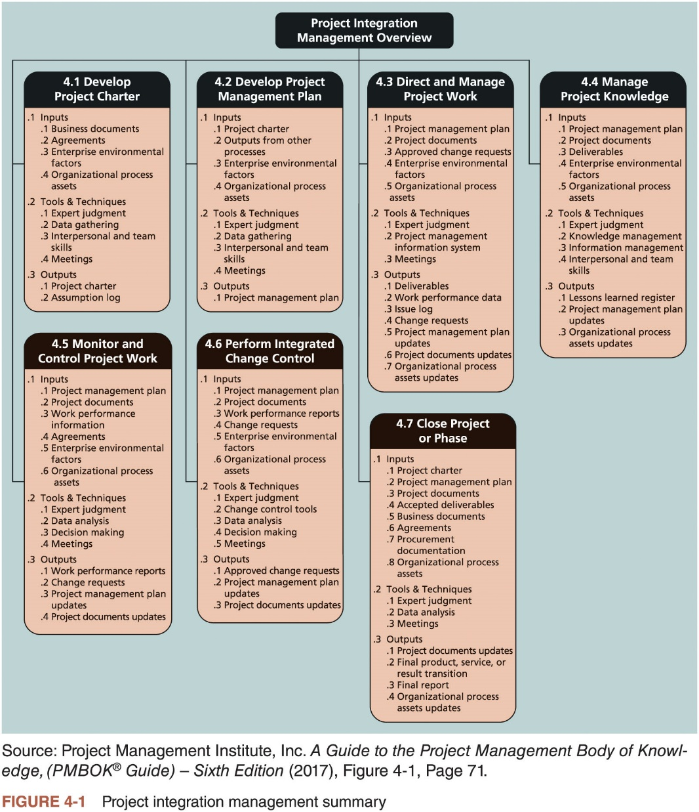
What is Project Integration Management? (3 of 3)

Slide 7
What Went Wrong?
Making sure people are paid is crucial to employee satisfaction
When a payroll system project doesn’t work, it is a disaster
Phoenix system project goal: reduce payroll processing overhead and staffing costs
One of the worst government-managed IT implementations ever
Civil servants paid through the system have been underpaid, overpaid, or not paid at all since its rollout began

Slide 8
Strategic Planning and Project Selection (1 of 3)
Strategic planning involves determining long-term objectives
Analyzing the strengths and weaknesses of an organization
Studying opportunities and threats in the business environment
Predicting future trends
Projecting the need for new products and services
SWOT analysis
Strengths, Weaknesses, Opportunities, and Threats
Identifying potential projects
Start of project initiation
Aligning IT with business strategy
Organization must develop a strategy for using IT to define how it will support the organization’s objectives

Slide 9
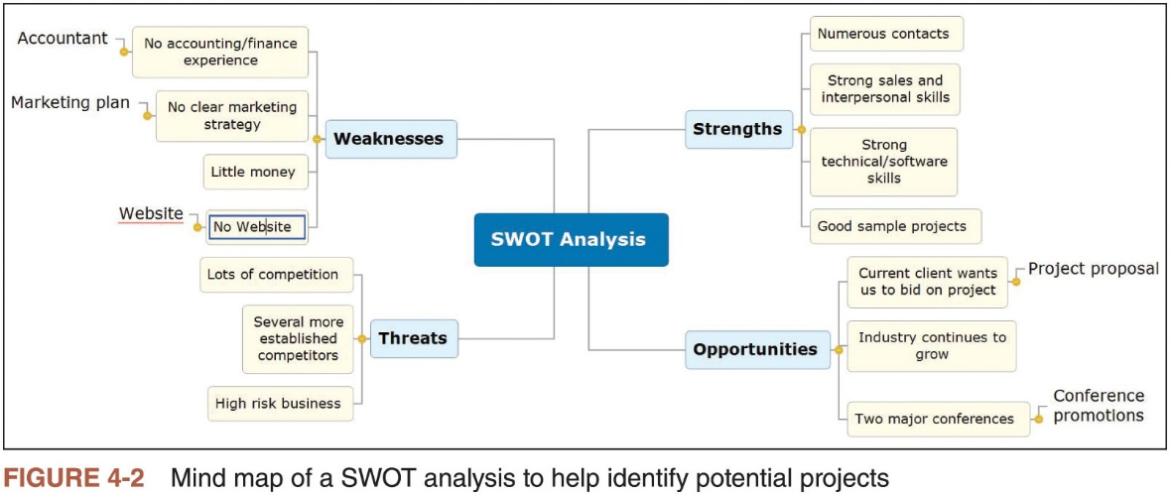
Strategic Planning and Project Selection (2 of 3)

Slide 10
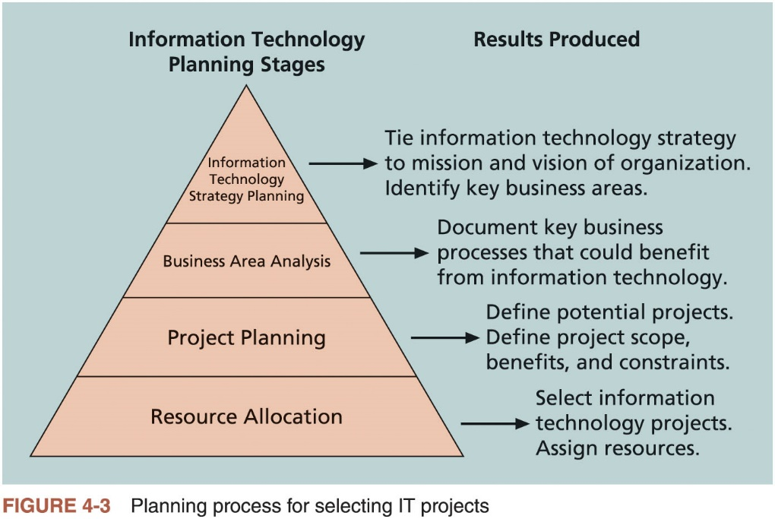
Strategic Planning and Project Selection (3 of 3)

Slide 11
Best Practice
In 2017 Fortune released their Business by Design list, highlighting the 24 companies they believe are using technology and globalization to find their competitive advantage
Apple: great design and learning to ‘think different’
Dyson: robotics and artificial intelligence research
Samsung: budget brand
Capital One: reinvented itself as a software company and innovation incubator

Slide 12
Methods for Selecting Projects
Potential projects must be narrowed down
Methods for selecting projects
Focusing on broad organizational needs
Categorizing information technology projects
Performing net present value or other financial analyses
Using a weighted scoring model
Implementing a balanced scorecard

Slide 13
Focusing on Broad Organizational Needs
Projects that address broad organizational needs are much more likely to be successful because they will be important to the organization
Examples: improve safety or increase morale
Important criteria for selecting projects
Need
Funding
Will

Slide 14
Categorizing IT Projects
Categorizations
Respond to a problem, opportunity, or directive
How long it will take to do and when it is needed
Overall priority of the project

Slide 15
Performing Financial Analyses
Financial considerations are often an important consideration in selecting projects
Regardless of current economics
Primary methods for determining the projected financial value of projects
Net present value (NPV) analysis
Return on investment (ROI)
Payback analysis

Slide 16
Net Present Value Analysis (1 of 4)
Method of calculating the expected net monetary gain or loss from a project by discounting all expected future cash inflows and outflows to the present point in time
Projects with a positive NPV should be considered if financial value is a key criterion
Projects with higher NPVs are preferred

Slide 17
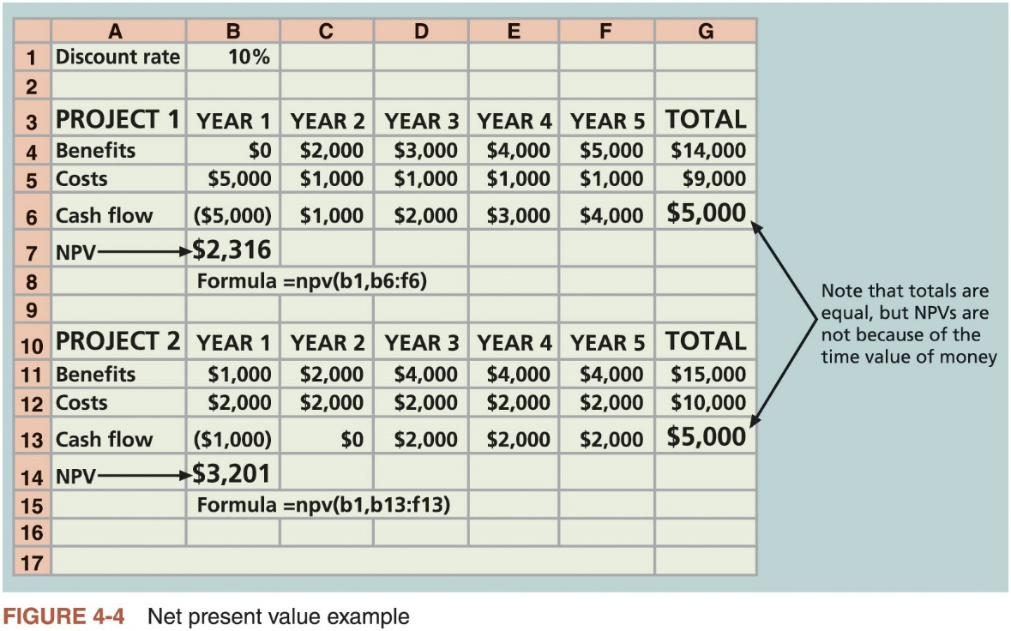
Net Present Value Analysis (2 of 4)

Slide 18
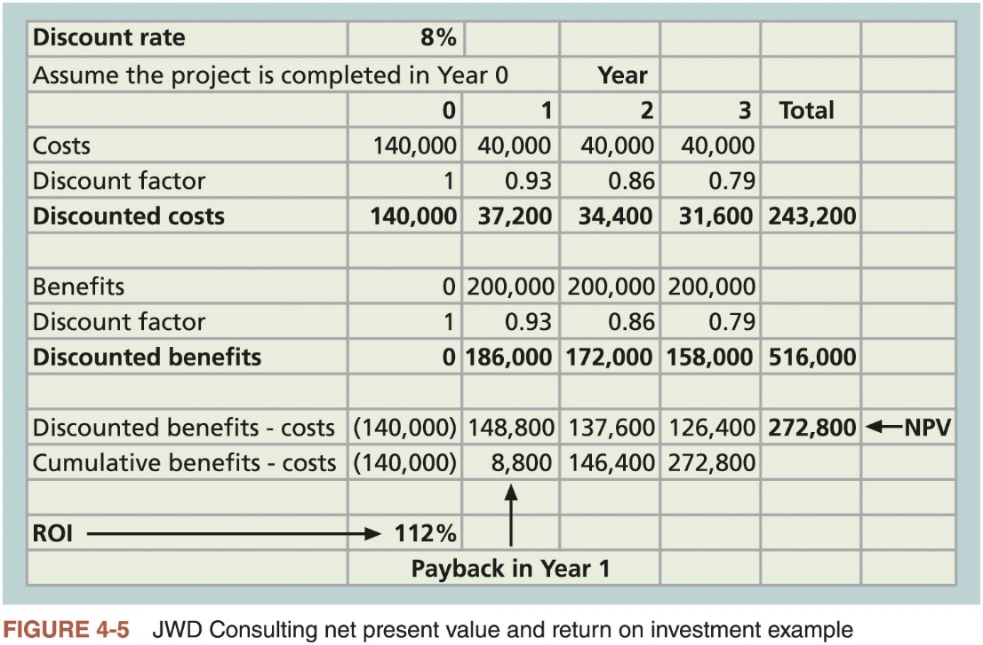
Net Present Value Analysis (3 of 4)

Slide 19
Net Present Value Analysis (4 of 4)
NPV calculations
Determine estimated costs and benefits for the life of the project and the products it produces
Determine the discount rate
Calculate the net present value
Important considerations
Some organizations refer to the investment year or years for project costs as Year 0 and do not discount costs in Year 0
Discount rate can vary, often based on the prime rate and other economic considerations
Costs can be entered as negative numbers and can be listed first (and then benefits)

Slide 20
Return on Investment
Calculated by subtracting the project costs from the benefits and then dividing by the costs
ROI = (total discounted benefits - total discounted costs) / discounted costs
The higher the ROI, the better
Many organizations have a required rate of return
Minimum acceptable rate of return on investment for projects
Internal rate of return (IRR) can by calculated by finding the discount rate that makes the NPV equal to zero

Slide 21
Payback Analysis (1 of 2)
Payback period is the amount of time it will take to recoup, in the form of net cash inflows, the total dollars invested in a project
Determines how much time will elapse before accrued benefits overtake accrued and continuing costs
Payback occurs when the net cumulative discounted benefits equals the costs
Many organizations have requirements for the length of the payback period of an investment

Slide 22
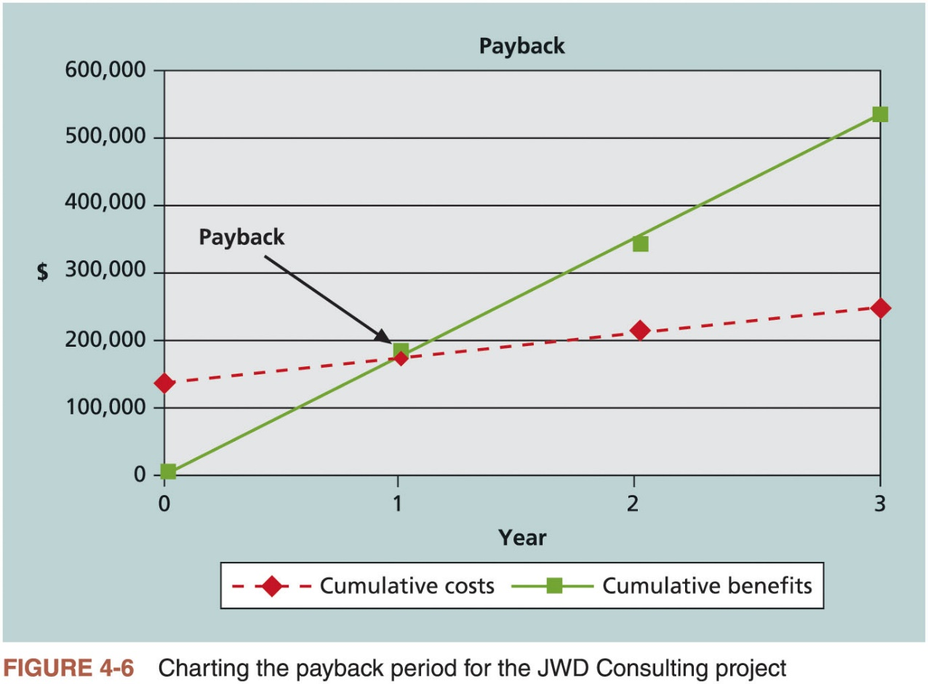
Payback Analysis (2 of 2)

Slide 23
Using a Weighted Scoring Model (1 of 2)
Provides a systematic process for selecting projects based on many criteria
Identify criteria important to the project selection process
Assign weights (percentages) to each criterion so they add up to 100%
Assign scores to each criterion for each project
Multiply the scores by the weights and get the total weighted scores

Slide 24
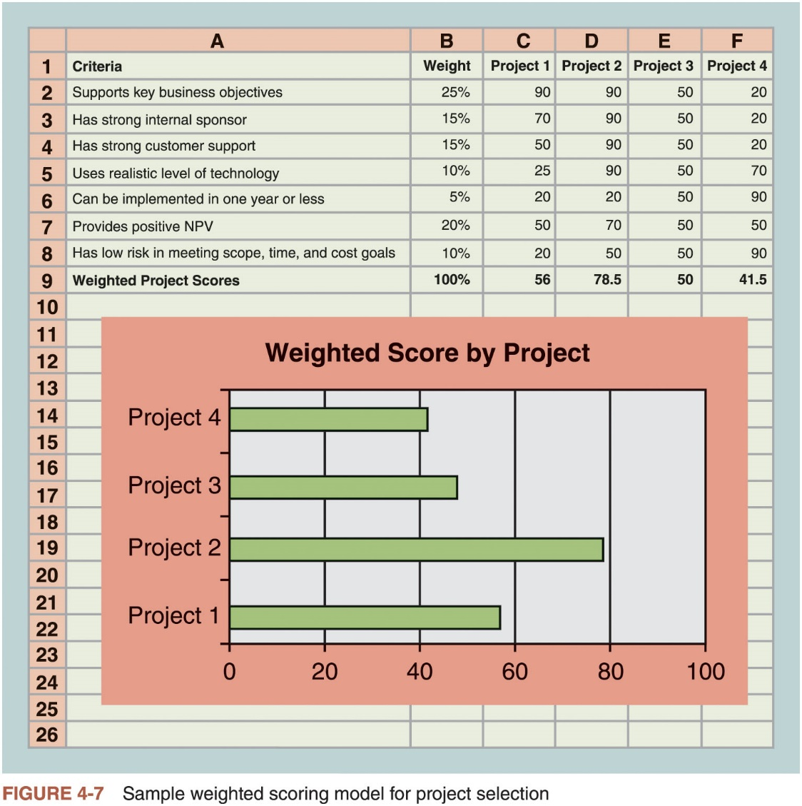
Using a Weighted Scoring Model (2 of 2)

Slide 25
Implementing a Balanced Scorecard
Drs. Robert Kaplan and David Norton developed this approach to help select and manage projects that align with business strategy
A balanced scorecard is a strategic planning and management system that helps organizations align business activities to strategy, improve communications, and monitor performance against strategic goals

Slide 26
Developing a Project Charter (1 of 2)
After deciding what project to work on, it is important to let the rest of the organization know
A project charter is a document that formally recognizes the existence of a project and provides direction on the project’s objectives and management
Key project stakeholders should sign a project charter to acknowledge agreement on the need and intent of the project
A project charter is a key output of the initiation process

Slide 27
Developing a Project Charter (2 of 2)
Inputs for developing a project charter
Business case
Benefits management plan
Agreements
Enterprise environmental factors
Organizational process assets

Slide 28
Developing a Project Management Plan
Document used to coordinate all project planning documents and help guide a project’s execution and control
Plans created in the other knowledge areas are subsidiary parts of the overall project management plan
Common elements of a project management plan
Introduction/overview of the project
Description of how the project is organized
Management and technical processes used on the project
Work to be done
Schedule and budget information
References to other project planning documents

Slide 29
Using Guidelines to Create Project Management Plans
Major Section Headings | Section Topics
Overview | Purpose, scope, and objectives; assumptions and constraints; project deliverables; schedule and budget summary; evolution of the plan
Project Organization | External interfaces; internal structure; roles and responsibilities
Managerial Process Plan | Start-up plans (estimation, staffing, resource acquisition, and project staff training plans); work plan (work activities, schedule, resource, and budget allocation); control plan; risk management plan; closeout plan
Technical Process Plans | Process model; methods, tools, and techniques; infrastructure plan; product acceptance plan
Supporting Process Plans | Configuration management plan; verification and validation plan; documentation plan; quality assurance plan; reviews and audits; problem resolution plan; subcontractor management plan; process improvement plan
Source: IEEE Standard 1058–1998.
Table 4-3 Sample contents for the IEEE software project management plan (SPMP)

Slide 30
Directing and Managing Project Work
Involves managing and performing the work described in the project management plan
The majority of time and money is usually spent on execution
The application area of the project directly affects project execution
Products of the project are produced during the execution phase
The project manager needs to focus on leading the project team and managing stakeholder relationships to execute the project management plan successfully
Project resource management, communications management, and stakeholder management are crucial to a project’s success

Slide 31
Coordinating Planning and Execution
Project planning and execution are intertwined and inseparable activities
The main function of creating a project management plan is to guide project execution
Those who will do the work should help to plan the work
All project personnel need to develop both planning and executing skills, and they need experience in these areas

Slide 32
Providing Strong Leadership and a Supportive Culture
Project managers must lead by example
Demonstrate the importance of creating and then following good project plans and following them in project execution
Organizational culture can help project execution
Providing guidelines and templates
Tracking performance based on plans
Project managers may still need to break the rules to meet project goals
Senior managers must support those actions

Slide 33
What Went Right?
2015 PMI report found that only 12 percent of organizations were considered to be high performers
Percentage has remained unchanged
Organizations must make major cultural changes to improve
Make sure everyone fully understands the value of project management
Require executive sponsors are fully engaged on projects and programs
Align projects to the organization’s strategy

Slide 34
Capitalizing on Product, Business, and Application Area Knowledge
It is often helpful for IT project managers to have prior technical experience
Small projects: the project manager may be required to perform some of the technical work or mentor team members to complete the projects
Large projects: the project manager must understand the business and application area of the project

Slide 35
Project Execution Tools and Techniques
Project managers can use specific tools and techniques to perform activities that are part of execution processes
Expert judgment
Meetings
Project management information systems

Slide 36
Managing Project Knowledge
Basic types of knowledge
Explicit knowledge: easily explained using words, pictures, or numbers and is easy to communicate, store, and distribute
Tacit knowledge: difficult to express and highly personal
Knowledge management should be done before, during, and after projects are completed
Often very difficult to accomplish

Slide 37
Advice for Young Professionals
Many college students excel in this area based on their experiences doing rigorous coursework
To stand out in your job, consider volunteering to be in charge of creating your project team’s lessons-learned register

Slide 38
Monitoring and Controlling Project Work
Changes are inevitable on most projects, so it’s important to develop and follow a process to monitor and control changes
Monitoring project work includes collecting, measuring, and disseminating performance information
The project management plan provides the baseline for identifying and controlling project changes
A baseline is a starting point, a measurement, or an observation that is documented so that it can be used for future comparison.

Slide 39
Media Snapshot
The 2002 Olympic Winter Games and Paralympics took five years to plan and cost more than $1.9 billion
PMI awarded the Salt Lake Organizing Committee (SLOC) the Project of the Year award for delivering world-class games
Four years before, the SLOC used a Primavera software-based system with a cascading color-coded WBS to integrate planning
Also used an Executive Roadmap, a one-page list of the top 100 Games-wide activities, to keep executives apprised of progress
Activities were tied to detailed project information within each department’s schedule
A 90-day highlighter showed which managers were accountable for each integrated activity
Fraser Bullock, SLOC Chief Operating Officer and Chief, said, “We knew when we were on and off schedule and where we had to apply additional resources. The interrelation of the functions meant they could not run in isolation—it was a smoothly running machine.”*
*Foti, Ross, “The Best Winter Olympics, Period,” PM Network (January 2004) 23

Slide 40
Performing Integrated Change Control
Main objectives
Influencing the factors that create changes to ensure that changes are beneficial
Determining that a change has occurred
Managing actual changes as they occur

Slide 41
Change Control on IT Projects
Former view: the project team should strive to do exactly what was planned on time and within budget
Problem: project teams could rarely meet original project goals
Modern view: project management is a process of constant communication and negotiation
Solution: changes are often beneficial and the project team should plan for them

Slide 42
Change Control System (1 of 3)
Formal, documented process that describes when and how official project documents and work may be changed
Describes who is authorized to make changes, paperwork required for these changes, and any automated or manual tracking systems the project will use
Change control board (CCB) is a formal group of people responsible for approving or rejecting changes on a project
Provide guidelines for preparing change requests, evaluate change requests, and manage the implementation of approved changes
Some CCBs only meet occasionally, so it may take too long for changes to occur
Some organizations have policies in place for time-sensitive changes

Slide 43
Change Control System (2 of 3)
Configuration management ensures that the descriptions of the project’s products are correct and complete
Involves identifying and controlling the functional and physical design characteristics of products and their support documentation
Configuration management specialists identify and document configuration requirements, control changes, record and report changes, and audit the products to verify conformance to requirements

Slide 44
Change Control System (3 of 3)
View project management as a process of constant communication and negotiation.
Plan for change.
Establish a formal change control system, including a change control board (CCB) and IT steering committee.
Use effective configuration management.
Define procedures for making timely decisions about smaller changes.
Use written and oral performance reports to help identify and manage change.
Use project management software and other software to help manage and communicate changes.
Focus on leading the project team and meeting overall project goals and expectations.
Table 4-4 suggestions for performing integrated change control

Slide 45
Global Issues
Rapid changes in technology, such as the increased use of mobile roaming for communications, often cause governments around the world to take action
Incompatible hardware, software, and networks can make communications difficult in some regions, and a lack of competition can cause prices to soar
Organisation for Economic Co-operation and Development (OECD) promotes policies that will improve the economic and social well-being of people around the world
In February 2012, the OECD called upon its members’ governments to boost competition in international mobile roaming markets
By the end of 2013, wireless broadband penetration grew to 72.4% in the OECD area

Slide 46
Closing Projects or Phases
To close a project or phase, you must finalize all activities and transfer the completed or cancelled work to the appropriate people
Main inputs are the project charter, project management plan, project documents, accepted deliverables, business documents, agreements, procurement documentation, and organizational process assets
Main tools and techniques are expert judgment, data analysis, and meetings

Slide 47
Using Software to Assist in Project Integration Management (1 of 2)
Several types of software can be used to assist in project integration management
Documents can be created with word processing software
Presentations are created with presentation software
Tracking can be done with spreadsheets or databases
Communication software can facilitate communications
Project management software can pull everything together and show detailed and summarized information

Slide 48
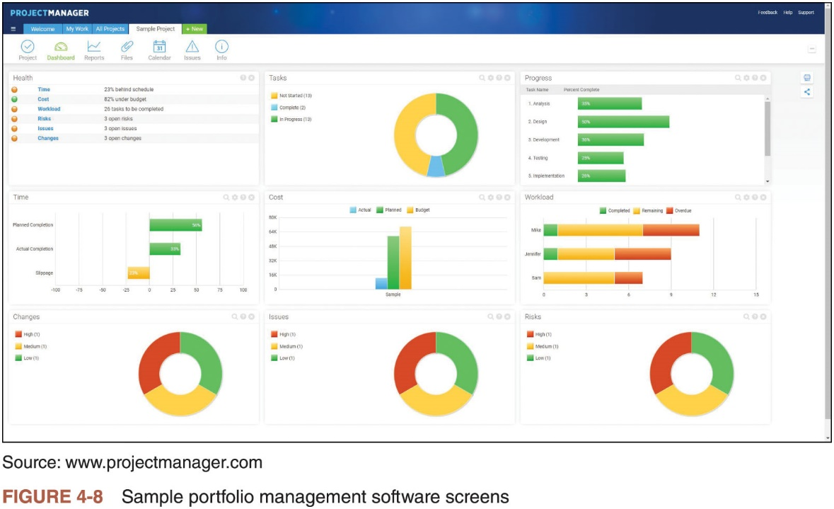
Using Software to Assist in Project Integration Management (2 of 2)

Slide 49
Considerations for Agile/Adaptive Environments
Iterative and agile approaches promote the engagement of team members
Expectations of the project manager do not change in an adaptive environment, but control of the detailed product planning and delivery is delegated to the team
Project managers using any product life cycle should focus on creating a collaborative decision-making environment and providing opportunities for team members to develop additional skills

Slide 50
Chapter Summary
Project integration management ties together all the other areas of project management
Primary focus should be on project integration management
Main processes
Develop the project charter
Create an assumption log
Develop the project management plan
Direct and manage project execution
Manage project knowledge
Monitor and control project work
Perform integrated change control
Close the project or phase

